Slide 1
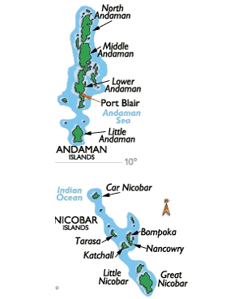
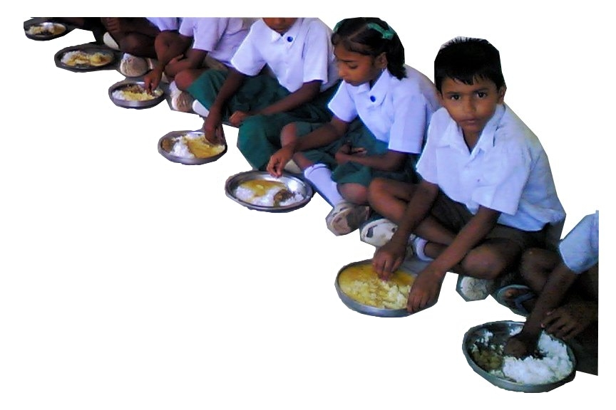
MID DAY MEAL SCHEME
ANNUAL WORK PLAN & BUDGET 2020-21
ANDAMAN AND NICOBAR ADMINISTRATION

Slide 2
Management Structure
Chief Secretary, A & N Administration
/ Chairman SSMC
Secretary (Education)
Director (Education)
Nodal Officer (MDM)
Zonal Officers / Principals of Education Department
Head of Schools
MDM Supplier

Slide 3
FUND FLOW
MHRD
UT ADMINISTRATION
EDUCATION DEPT.
DDOs OF EDUCATION DEPT.
SELF HELP GROUPS

Slide 4
FLOW OF FOOD GRAINS (RICE)
MHRD releases allocation orders
Food Corporation of India
Transported to go-downs of CS & CA Dept located in 09 different zones of this UT
Suppliers lift from respective godowns depending on proximity
Lifting by Civil Supplies & Consumer Affairs Dept on Quarterly basis

Slide 5
NUMBER OF INSTITUTIONS COVERED DURING 2019-20
District | Number of Schools
 | Govt. | Govt. Aided | Local Body | Total
South Andaman | 112 | 02 | 02 | 116
N & M Andaman | 157 | 00 | 04 | 161
Nicobar | 55 | 00 | 00 | 55
Total | 324 | 02 | 06 | 332
PER UNIT COOKING COST DURING 2019-20
Stage | Central Share (100%) | UT Contribution | Total
Primary | Rs. 4.48 | Rs. 6.00 | Rs. 10.48
Upper Primary | Rs. 6.71 | Rs. 6.00 | Rs. 12.71

Slide 6
ACHIEVEMENT DURING THE FY 2019-20 UPTO 31.12.2019
Average number of children availed MDM
 | Achievement
Stage | % coverage against enrolment | % coverage against PAB approval
Primary | 78.11 % | 100.98 %
Upper Primary | 80.36% | 103.55%

Slide 7
Allocation & Utilization of Food grains upto 31.12.2019
In MTs
Stage | Total Allocation for FY 2019-20 | Utilization | Percentage of utilization against allocation
Primary | 308.37 | 212.32 | 68.85 %
Upper Primary | 332.77 | 234.94 | 70.60 %
Total | 641.14 | 447.26 | 69.76 %
Allocation & Utilization of funds for Food grains upto 31.12.2019
In Lakhs
Bill Raised by FCI | Payment made to FCI | Percentage
10.93 | 10.93 | 100%

Slide 8
Financial Achievement during 2019-20
Upto 31.12.2019
Central Assistance :-
(in Lakhs)
Sl. No. | Component | Approved outlay | Fund received | Fund utilized
1 | Cooking Cost | 278.56 | 172.2 | 133.78
2 | Cost of Food grain | 19.23 | 11.23 | 10.93
3 | Transportation Assistance | 4.8 | 2.8 | 2.76
4 | Honorarium to CCH | 72.1 | 43.26 | 43.26
5 | MME | 10.12 | 6.2 | 1.98
Total |  | 384.81 | 235.69 | 192.71
UT Fund:-
(in Lakhs)
UT Fund | Fund Allocated for MDM including UTs Scheme of supplementary nutrition | Expenditure till 31.12.2019 | %
 | 500.00 | 375.00 | 75 %

Slide 9
Status of construction of Kitchen cum Stores
No. of Kitchen Cum Stores sanctioned by MHRD | Constructed | Yet to start
251 Units | 169 Units | 76 Units
251 Kitchen cum Stores sanctioned in the year 2013-14 with a project cost of 1720 Lakh to be shared by MHRD and UT on 75:25 sharing basis.
Out of 1290 Lakh being the Central Share, MHRD released 802.30 Lakhs.
Out of 802.30 Lakh , this UT booked an amount of Rs. 689.21 Lakh and Rs. 113.09 Lakhs was surrendered.
No sanctions for construction of Kitchen–cum-store during 2017-18 & 2018-19 were made by PAB.
Govt. of India released Rs. 3.62 crores during fagend of 2019-20 for construction of 80 kitchen cum store against the total demand of Rs. 6.31 crores.
Executing agency expressed inability to utilize this grant during 2019-20 due to late release of fund. Therefore revalidation is required for utilization of this grant during 2020-21.
Difference of Rs. 2.69 crores may also be released during 2020-21 to accomplish the target.

Slide 10
Status of Kitchen Devices
No. of institutions | Sanctioned by MHRD | Replacement during the year 2018-19
332 | 332 | 127
During the Financial year 2018-19, MHRD released an amount of Rs. 6.35 Lakhs for replacement of Kitchen devices procured during the year 2006-07 from UT grant.

Slide 11
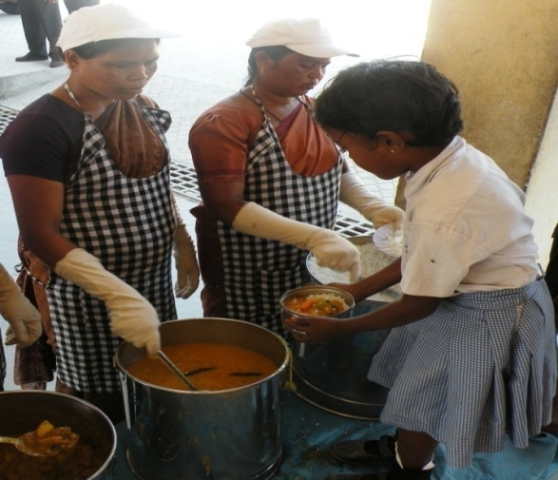
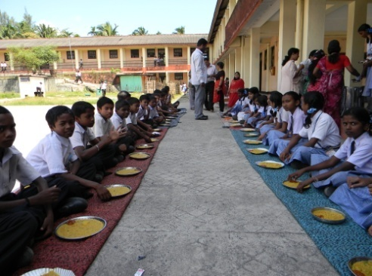
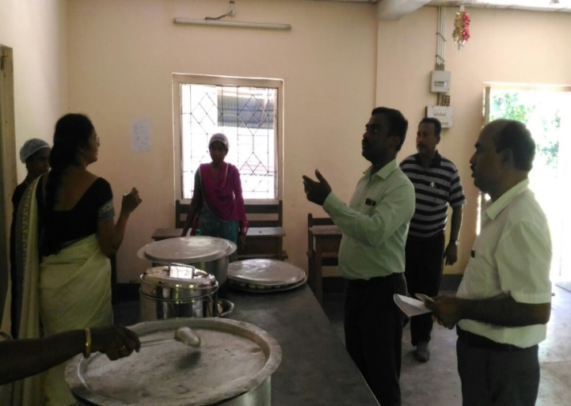
GOOD PRACTICES ADOPTED
Boiled egg thrice in a week and ripened Banana twice in a week are being provided to the students of Pre-Primary Stage to Upper-Primary Stage as Supplementary Nutrition.
Washing Hands before Consuming Meals is mandatory.
Wearing Headgears, Aprons and Hand Gloves compulsory for staff cooking and serving MDM.
Tasting of food by teachers / SMC members before serving is a regular practice.
Every School has Standard Operative Procedures to be followed during emergency.

Slide 12
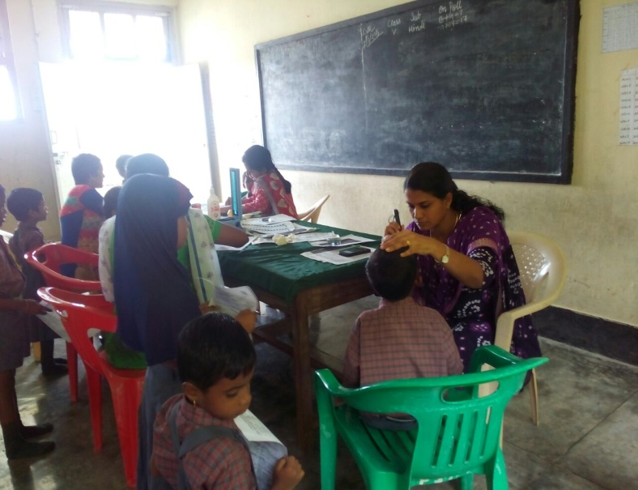

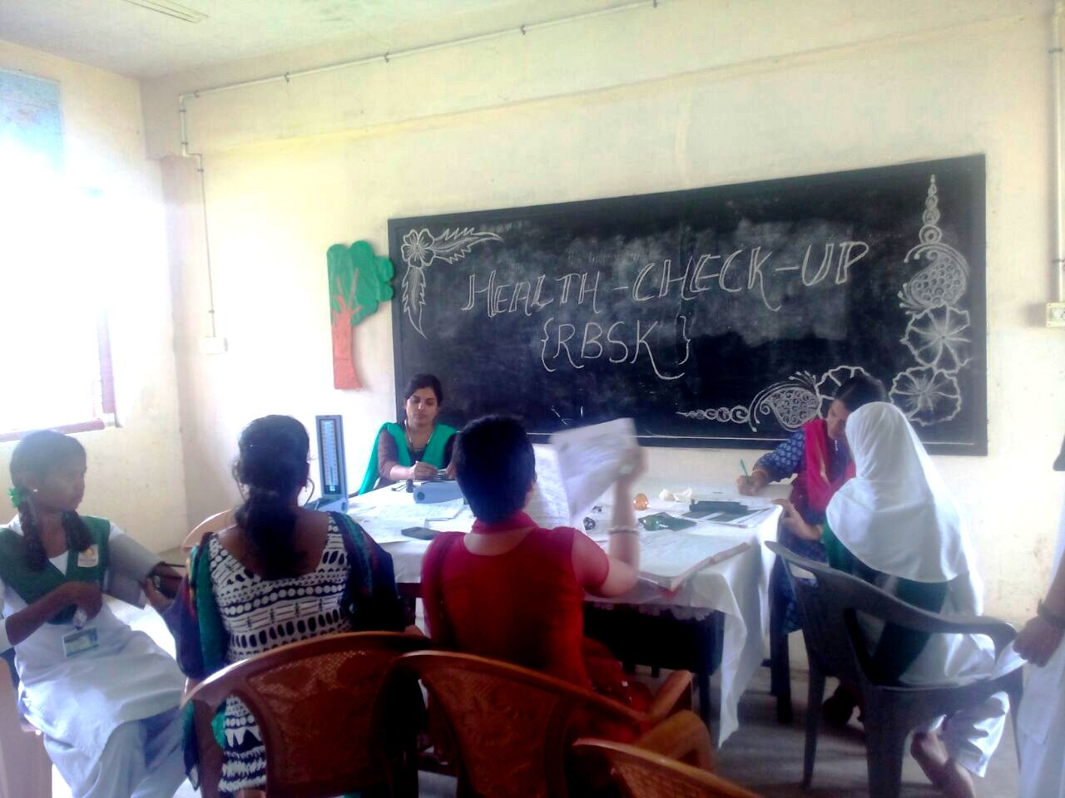
Coverage under School Health Programme
Upto 31.12.2019
Health Check Up
No. of students covered 28306
Distribution of IFA Tablets
No. of students covered 28306
Distribution of Spectacles
No. of students covered 31
No. of schools covered
297

Slide 13
Action taken note on the commitments made by the UT in the last PAB Meeting
No. information of implementation of Tithi Bhojan
Instructions are in place to organize Tithi Bhojan in schools. All Zonal Officers, DDOs and Head of Institutions are requested to disseminate the information to all stake holders, but till date nobody turned up for the same, however efforts are being done by the Head of Institutions.
Training to Cook Cum Helpers (CCH)
A&N Does not have any designated Food Craft Institutions (FCI) for imparting training to Cook-Cum-Helpers. Moreover, CCH were appointed by Self Help Groups, which keeps on changing from time to time.
3. Social Audit not yet conducted
Since this UT has not identified the agencies for Social audit, social audit could not be conducted. UT proposes that MHRD may depute experts in the field to disseminate information on various parameters of social audit so that this UT may work out and action plan for conducting the social audit

Slide 14
4. Only 39% Schools are covered on Automated Monitoring System
Due to poor net connectivity data of all schools can not be uploaded. However, during this FY 2019-20 the coverage has been reached to 230-240 schools per day.
5. LPG Coverage 33% (only 99 schools out of 332)
In A&N Islands, supply of domestic LPG cylinder is irregular due to transportation / geographical constraints. In view of this, regular supply of Cooked Mid Day Meal to the students may hamper if we opt for LPG. Moreover, the MDM is supplied by Self Help Group and in most of places, traditional cooking system is adopted by the Self Help Group in which fire-wood is used for cooking.
6. To conduct atleast one meeting of District Level Steering Cum Monitoring Committee per moth per district
In this UT, District Steering cum monitoring committee is headed by the Deputy Commissioners. Block Level officers are co-ordinating with District Administration for regular conduct of meeting as per the guidelines of Mid Day Meal

Slide 15
PROPOSAL FOR F.Y 2020-21
Anticipated number of working days : | 220 days (Primary & Upper Primary)
Targeted no. of children as per achievement of F.Y 2019-20 upto 31.12.2019
Primary | 14155
Upper Primary | 10442
Total | 24597
Requirement of Food Grains for 2019-20
Stage |  | Requirement in MTs
Primary @ 100 gms / day /child |  | 311.41
Upper Primary @ 150 gms /day / child |  | 344.58
 | Total | 655.99

Slide 16
Requirement of Central Assistance for recurring components (in Lakhs)
Sl. No. | Component | Requirement
1 | Cooking Cost | 293.65
2 | Cost of Foodgrains | 19.67
3 | Transportation Assistance | 4.91
4 | Honorarium to Cook cum helpers | 72.1
5 | Management Monitoring and Evaluation | 10.54
 | Total | 400.87

Slide 17
MANAGEMENT, MONITORING AND EVALUATION PLAN (MME -PLAN)
Sl. No. | Component | Fund Required
1. | Strengthening of MIS / engagement of manpower | Rs. 51.30 Lakhs
2. | Printing of relevant manuals / forms and stationeries | Rs. 2.00 Lakhs
3. | Training to Cook cum Helpers | Rs. 10.00 Lakhs
4. | Capacity building of officials | Rs. 3.00 Lakhs
5. | Publicity of Scheme / IEC Activity | Rs. 3.00 Lakhs
6. | External Monitoring and Evaluation | Rs. 3.00 Lakhs
7. | Installation of Dustbin (332x Rs.5000/-) | Rs. 16.60 Lakhs
8. | Installation of RO Plant (48 x Rs. 20000/-) | Rs. 9.60 Lakhs
Total |  | Rs. 98.50 Lakhs

Slide 18
THANK YOU

